Slide 1

Using this template
Call to action. What do you want people to do at this stage, based on the link you’re providing? Examples:
Register now
Watch online
Event name
Thematic image. Use one with a no-attribution licence (like from Unsplash or Pixabay) unless you have permission to use the image in this way; or it’s an attribution-required image and you include the attribution with the image or on the page it links to.
Location and date/time
Other details, like a blurb of the event, should be included in text (not in the image). It is highly recommended you include ALL information in text, beneath the image – ideally in addition to a link to an event page that contains all the details.

Slide 2
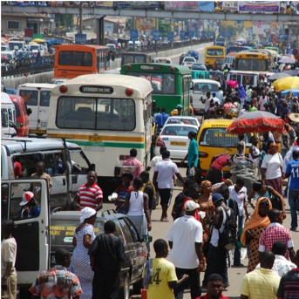


Africa Climate Week: taking action on air pollution and climate change
Accra, Ghana
19 March 2019
9:30 – 12:30

Slide 3
Saving your image
When you’re done, go to Save As and save this presentation as PNG.
Other notes
You must have the SEI brand font, Calibre, installed for this template to work.
Remember to create an event page on the SEI website if this is an SEI-hosted or co-hosted event. You can then link to that page in your communications about the event. Event pages must be edited by a member of the editorial team.
Contact Moa Engström if you have questions about the SEI brand.

