Slide 1

Policy for increased circularity in post-consumer textiles in the Baltic States
Harri Moora
SEI Tallinn

Slide 2
The basis for policy development
Who are the main actors?
What is the situation concerning the collection, reuse, recycling other treatment?
What are the opportunities as well as barriers and challenges that hinder the development?
Policy measures
(e.g priorities, targets, roles and responsibilities, EPR, possible governmental support and funding mechanism, etc)

Slide 3

Main actors – roles and responsibilities?
Many actors (charities, private collectors and importers, waste management companies, municipalities, etc)
Difficult to get data
Collaboration between different actors is weak
Reuse sector versus waste management sector
The role of authorities?

Slide 4
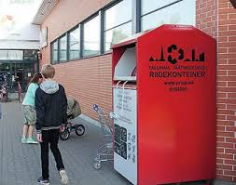
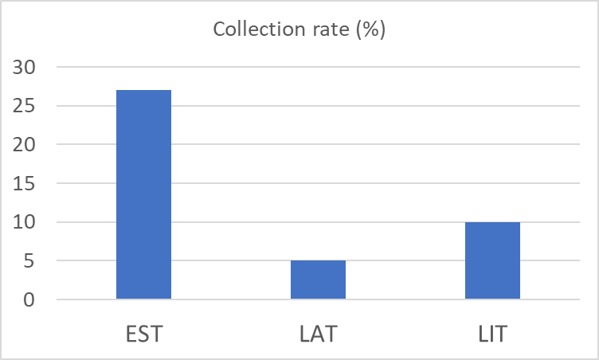
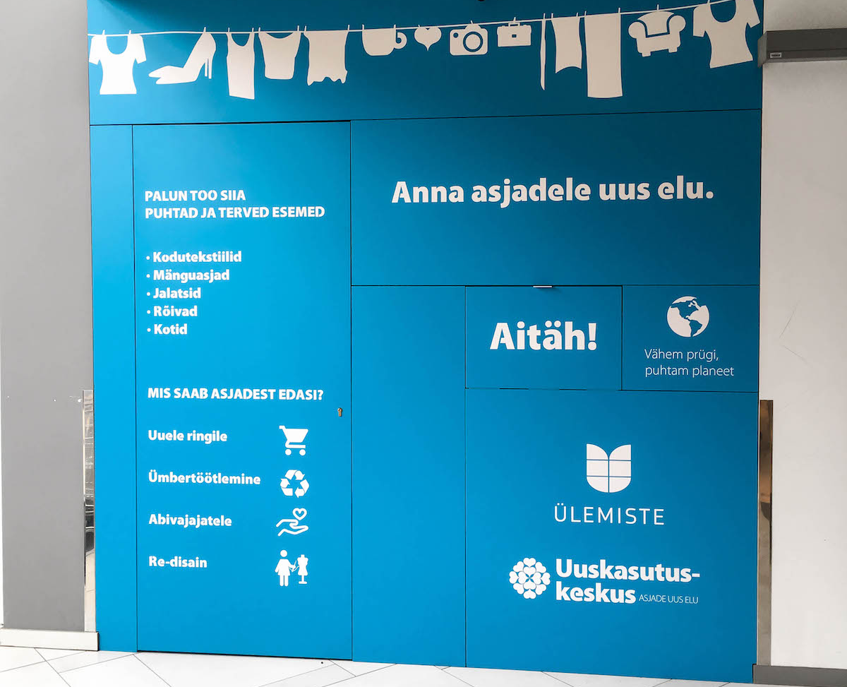
Targets – collection, reuse or recycling?
Collection of post-consumer textiles
  Collection is increasing in all Baltic countries (container collection + collection points)
  Collection rate in Estonia ca 27% (1/3 of that is separately collected as waste and then still incinerated or landfilled!), Latvia 5%, Lithuania 10%
  Collection is mainly focused on reusable textiles/clothing

Slide 5
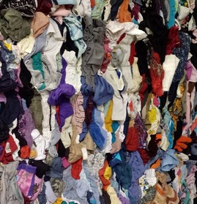
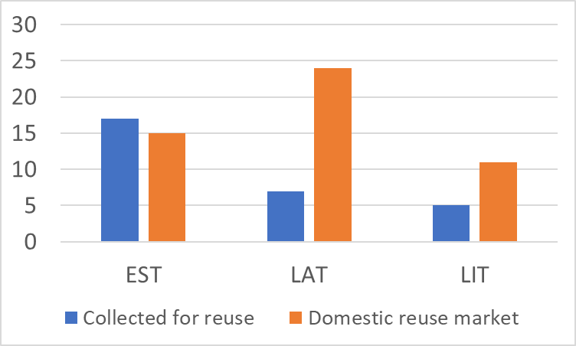
Targets – collection, reuse or recycling?
Reuse of post-consumer textiles
  The share of reused post-consumer textiles in Estonia 17% (12%), Lithuania 7%, Latvia 5%
  Domestic reuse market is up to 25% (based on our study: Estonia 15%, Lithuania 24%, Latvia 11%)
  The potential of domestic reuse is relatively high
Recycling of post-consumer textiles
  Very few possibilities for local recycling of post-consumer textile waste
  The main barrier for further development of circular textile industry

Slide 6
Policy measures
Measures supporting
increased collection –
collection obligation
for municipalities
to secure collection
network, etc
Voluntary actions –
commitments and
standards to engage
stakeholders
Targets
for increased collection, reuse and recycling
Nordic-
Baltic
cooperation
Baltic
cooperation
Economic incentives –
EPR,
tax relief, etc
Measures
supporting
reuse and recycling
business and infrastructure
Circular public
procurement –
reuse/recycling
content
Informative measures –
information campaigns, etc

