Slide 1
EU policy regarding textile waste
Chiel Berends
European Commission
DG Environment
Riga, 9 September 2019

Slide 2
Textiles in the EU
Textile and clothing industry in the EU
  Employs 1.7 million people in the EU and generates a turnover of EU 166 billion
Wide sustainability aspects
  Production
  Use phase
  End-of-life / after use
Increased consumption
Low rate of recycled content

Slide 3
Used textiles in the EU
Limited data available
Separate collection that facilitates
  re-use
  high-quality recycling
Collection rates vary significantly within the EU

Slide 4
Textile waste prevention and treatment
Reuse
  Domestic reuse markets in Europe are limited to the top 10-20% in quality of used textiles.
Recycling of textiles is limited
  Sorting
  Blended fibres
  Legacy issues
  Mechanical / chemical recycling

Slide 5
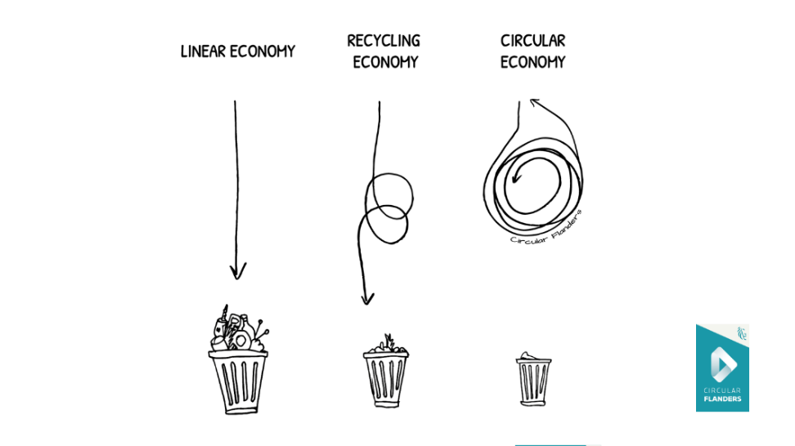
Source: Circular Flanders / OVAM (Public Waste Agency of Flanders)

Slide 6
EU waste legislation

Slide 7
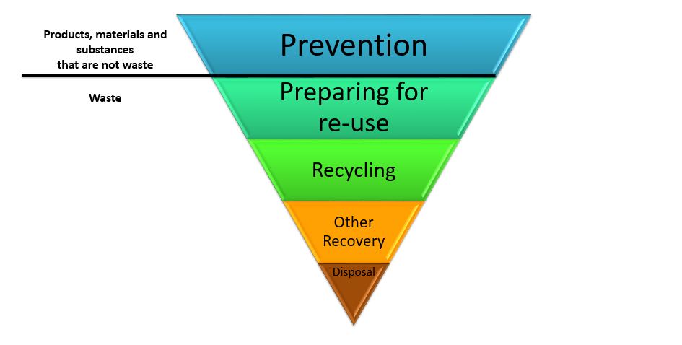
The Waste Hierarchy

Slide 8
The revised WFD
Recycling targets for municipal waste and packaging waste
Landfill diversion targets for municipal waste
Extended separate collection for municipal waste: MS to ensure separate collection of at least paper, metal, plastic, glass, bio-waste (by end 2023), hazardous household waste and textiles (by end 2024)
Minimum requirements for EPR schemes

Slide 9
Waste Prevention
MS shall take measures to prevent waste generation, incl.:
Encourage the re-use of products and the setting up of systems promoting repair and re-use activities, including in particular for [...] textiles [...]
Promote sustainable production + consumption models
Promote reuse and repair [..]
MS shall develop and support information campaigns to raise awareness about waste prevention and littering

Slide 10
Revisions & Follow-up
Art. 11 (1) requires Member States to set up separate collection at least for paper, metal, plastic and glass, and, by 1 January 2025, for textiles.
Art. 11 (6), states that, by 31 December 2024, the Commission shall consider the setting of preparing for re-use and recycling targets for a.o. textile waste.

Slide 11
Revisions & Follow-up
Commission to establish a common methodology to report on re-use of products
By the end of 2024, Commission shall consider the feasibility of measures to encourage the re-use of products

Slide 12
Guidance on separate collection
Ongoing study to support the Commission in establishing guidelines for separate collection of waste
Plastic waste, bio-waste, textile waste, hazardous household waste

Slide 13
EPR
Ongoing study to support preparation of the Commission's guidance on the implementation of the general minimum requirements for extended producer responsibility schemes set out in Article 8a of the revised WFD

Slide 14

POLITICAL GUIDELINES FOR THE NEXT EUROPEAN COMMISSION 2019-2024
“I will propose a European Green Deal in my first 100 days in office.”
“I will propose a New Circular Economy Action Plan focusing on sustainable resource use, especially in resource-intensive and high-impact sectors such as textiles and construction.”

Slide 15
Source: Circular Flanders / OVAM (Public Waste Agency of Flanders)

Slide 16
Learn more about EU policy on the circular economy and waste:
http://ec.europa.eu/environment/circular-economy/index_en.htm
ec.europa.eu/environment/waste

