Slide 1




Schools’ Air quality Monitoring for Health and Education
Dr. Rhys Archer
SEI York / University of York
Notes:
Thank you for inviting me to be here today. I’m Rhys Archer, and I’m a Research Fellow at SEI York, based at the University of York. SEI is a global research organisation tackling environment and development challenges. I’m not an IAQ specialist, but instead I am a research scientist interested in using participatory methods to make research more relevant, more widely translated to the general public, and enriched. SAMHE stands for Schools' Air quality Monitoring for Health and Education and brings together scientists, pupils and teachers. SAMHE is establishing a network of air quality monitors in schools across the UK, to generate an unparalleled dataset which will help researchers better understand schools indoor air quality.Schools get a free high spec air quality monitor that measures carbon dioxide (CO2), volatile organic compounds (VOCs) particulate matter (PM), temperature and relative humidity. Teachers and pupils can access their data through a specially designed interactive Web App, seeing how air quality changes over the course of hours, days or weeks and months.
The Web App also offers a range of related activities and experiments, creating opportunities for pupils to be scientists and do hands-on experiments with their monitor.
More on that soon…

Slide 2
What is Citizen science?
The involvement of members of the public in meaningful scientific research
BUT defining citizen science is difficult! There are contested definitions of the term, what should and should not be classed as citizen science, and even debate about whether it should be defined or not!
It is difficult to define because:
It covers a huge range of approaches
It spans a wide range of disciplines, including natural sciences and increasingly social sciences and humanities
It has a diversity of purposes
It takes places in a variety of cultural contexts
It also overlaps with a range of other participatory research approaches
Notes:
The reason I use citizen science approaches in my work is that there are benefits for the science, and for those participating. There are different forms of citizen science, depending on how many stages of the scientific process participants are involved in.

Slide 3
Citizen science and SAMHE
Research focus
Methods development
Data collection
Data analysis
Dissemination
  Proposing topics
  Developing hypotheses and research questions
  Proposing methods
  Developing and refining methods
  Trialling methods
  Collecting data
  Inputting data
  Processing data
  Analysing data for scientists
  Analysing data for other purposes
  Interpreting data
  Contributing to or leading on outputs
  Sharing results via social media, in person meetings
Contributory
Collaborative
Co-created
Notes:
SAMHE is a collaborative citizen science project, as schools have been involved in helping design the project, collecting data, and they will also analyse their data themselves. There are many benefits for participants of participating in SAMHE. Through using our custom built Web App, which was co-designed with schools, pupils (and their teachers) will gain knowledge and understanding of what affects air quality – the monitors measure PM2.5, TVOCs, CO2, temperature and relative humidity. They will also gain scientific enquiries skills, and other skills such as persuasive writing. Importantly, they will also gain knowledge about what to do to improve air quality, through activities which will ask them to take action such as opening and closing windows and doors. The scientists get to collect data from school classrooms about particulate matter and total volatile organic compounds, as well as temperature, relative humidity, and CO2.
Not just engagement..

Slide 4


Citizen science
Benefits for science and for participants
Pupils (and teachers) gain knowledge and understanding of air quality
Skills
Knowledge of what action to take
New data about air quality in schools (PM, TVOCs, temp, humidity, CO₂)

Slide 5
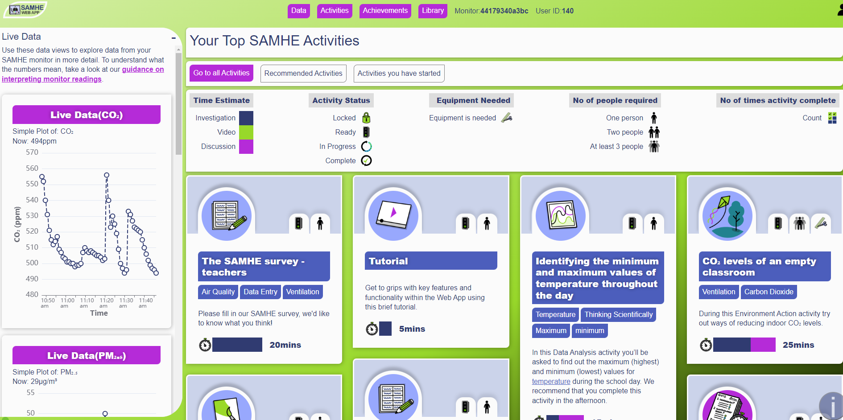
Notes:
Here you can see a screenshot of the Web App, on the left you can see a graph showing data, and if I were to click on this in the Web App, you’d be able to expand and interrogate the live data. On the right you can see some of the activities available to me, these are greyed out as I haven’t completed the tutorial which helps me understand what my data mean. But you can see an activity about identifying maximum and minimum temperature, and another about CO2 levels.

Slide 6
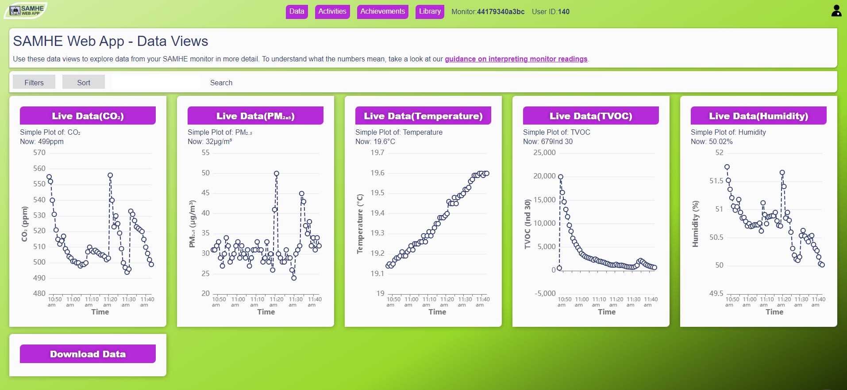
Notes:
Closer look at the data available

Slide 7
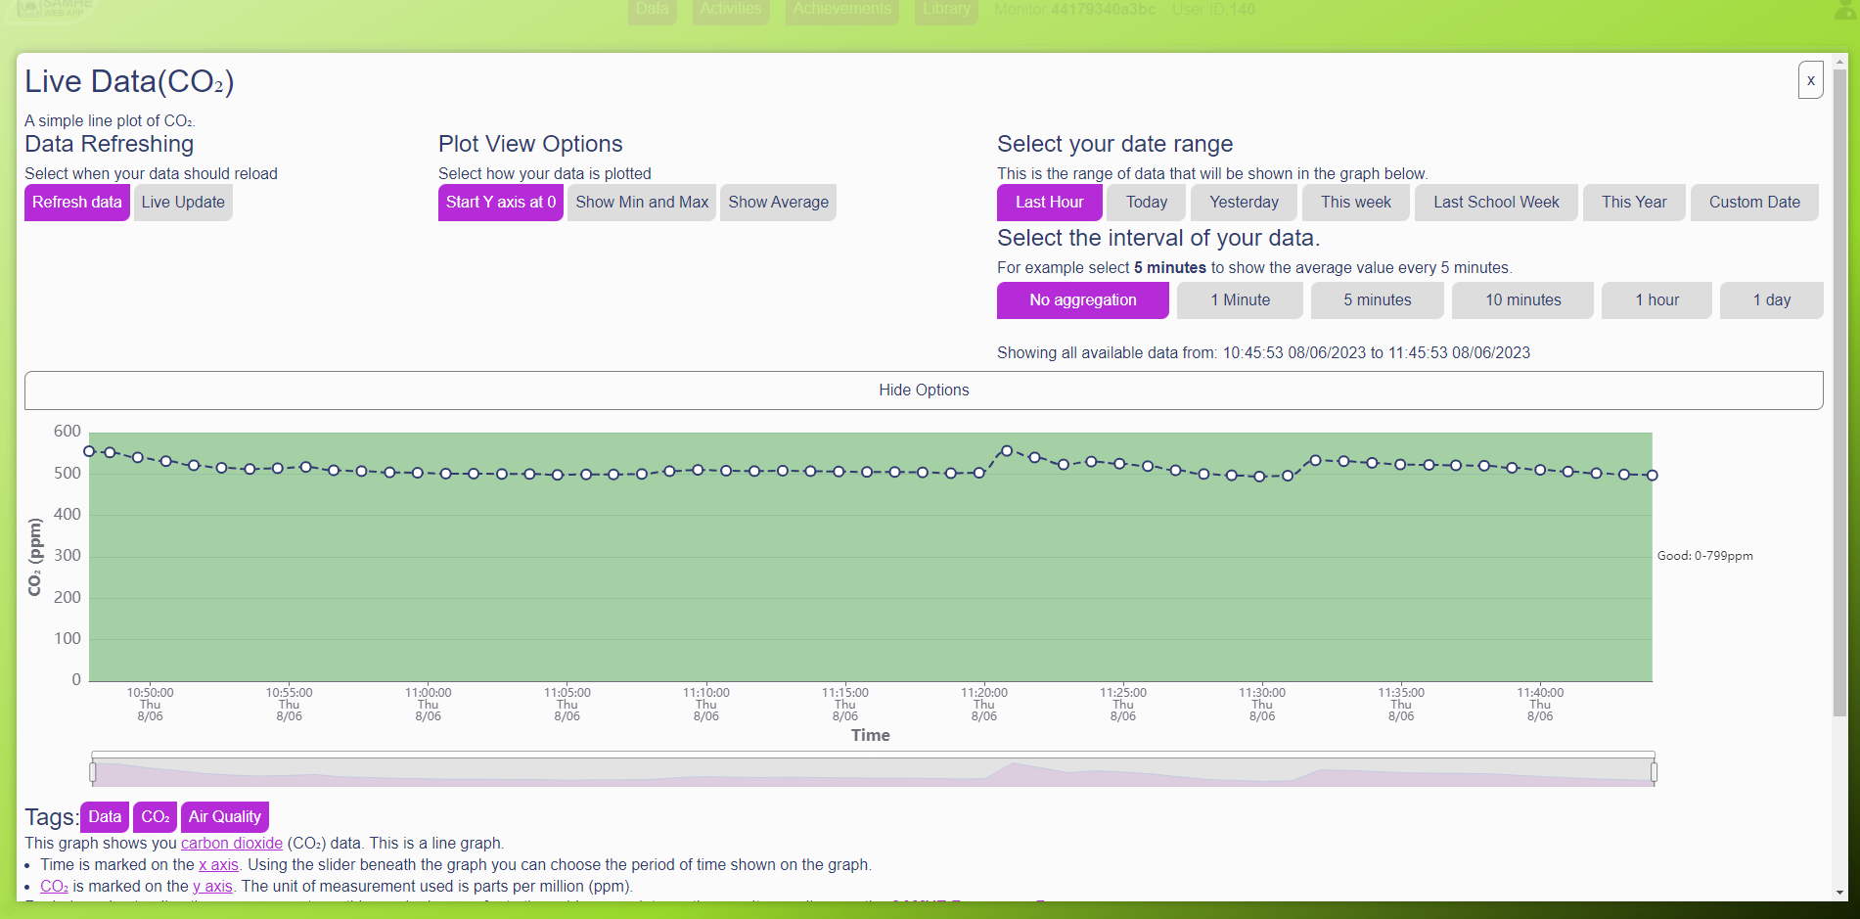
Notes:
Manipulation of data

Slide 8
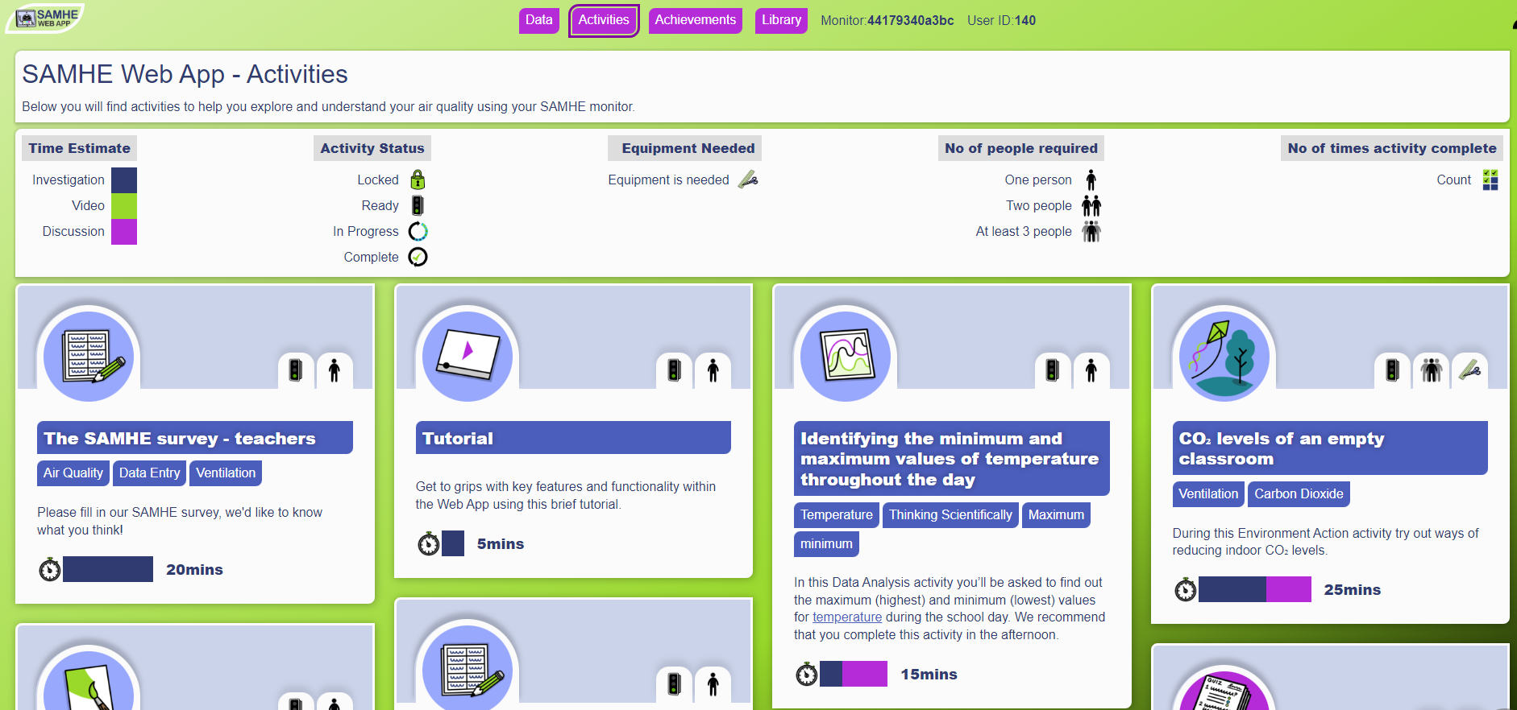
Notes:
Activities

Slide 9



123
800
2,000
Schools in our Co-Design and Pioneer phases
Schools signed up so far
Target schools across the UK
Notes:
We had 123 Schools sign up to take part in our Co-Design or Pioneer stages, and these schools helped us design the logo, decide on the look and style of the Web App, and the need for curriculum linked resources. SAMHE launched to all schools at the end of April and already has over 800 schools signed up to receive a monitor, aiming to send a total of 2000 out to all corners of the UK over the next year, meaning this will be the largest school air quality monitoring scheme in the world.

Slide 10

The SAMHE monitor and app have provided our Y4/5 science group with a wealth of data to interrogate and analyse. The children’s enthusiasm has been infectious and there is tangible excitement at being able to access the data in real time…We are now determined to continue, working towards earning all the achievement badges
Teacher, SAMHE Co-Design school
Notes:
One of our Co-Design school teachers said “The SAMHE monitor and app have provided our Y4/5 (that’s age 9-10) science group with a wealth of data to interrogate and analyse. The children’s enthusiasm has been infectious and there is tangible excitement at being able to access the data in real time…We are now determined to continue, working towards earning all the achievement badges”

Slide 11
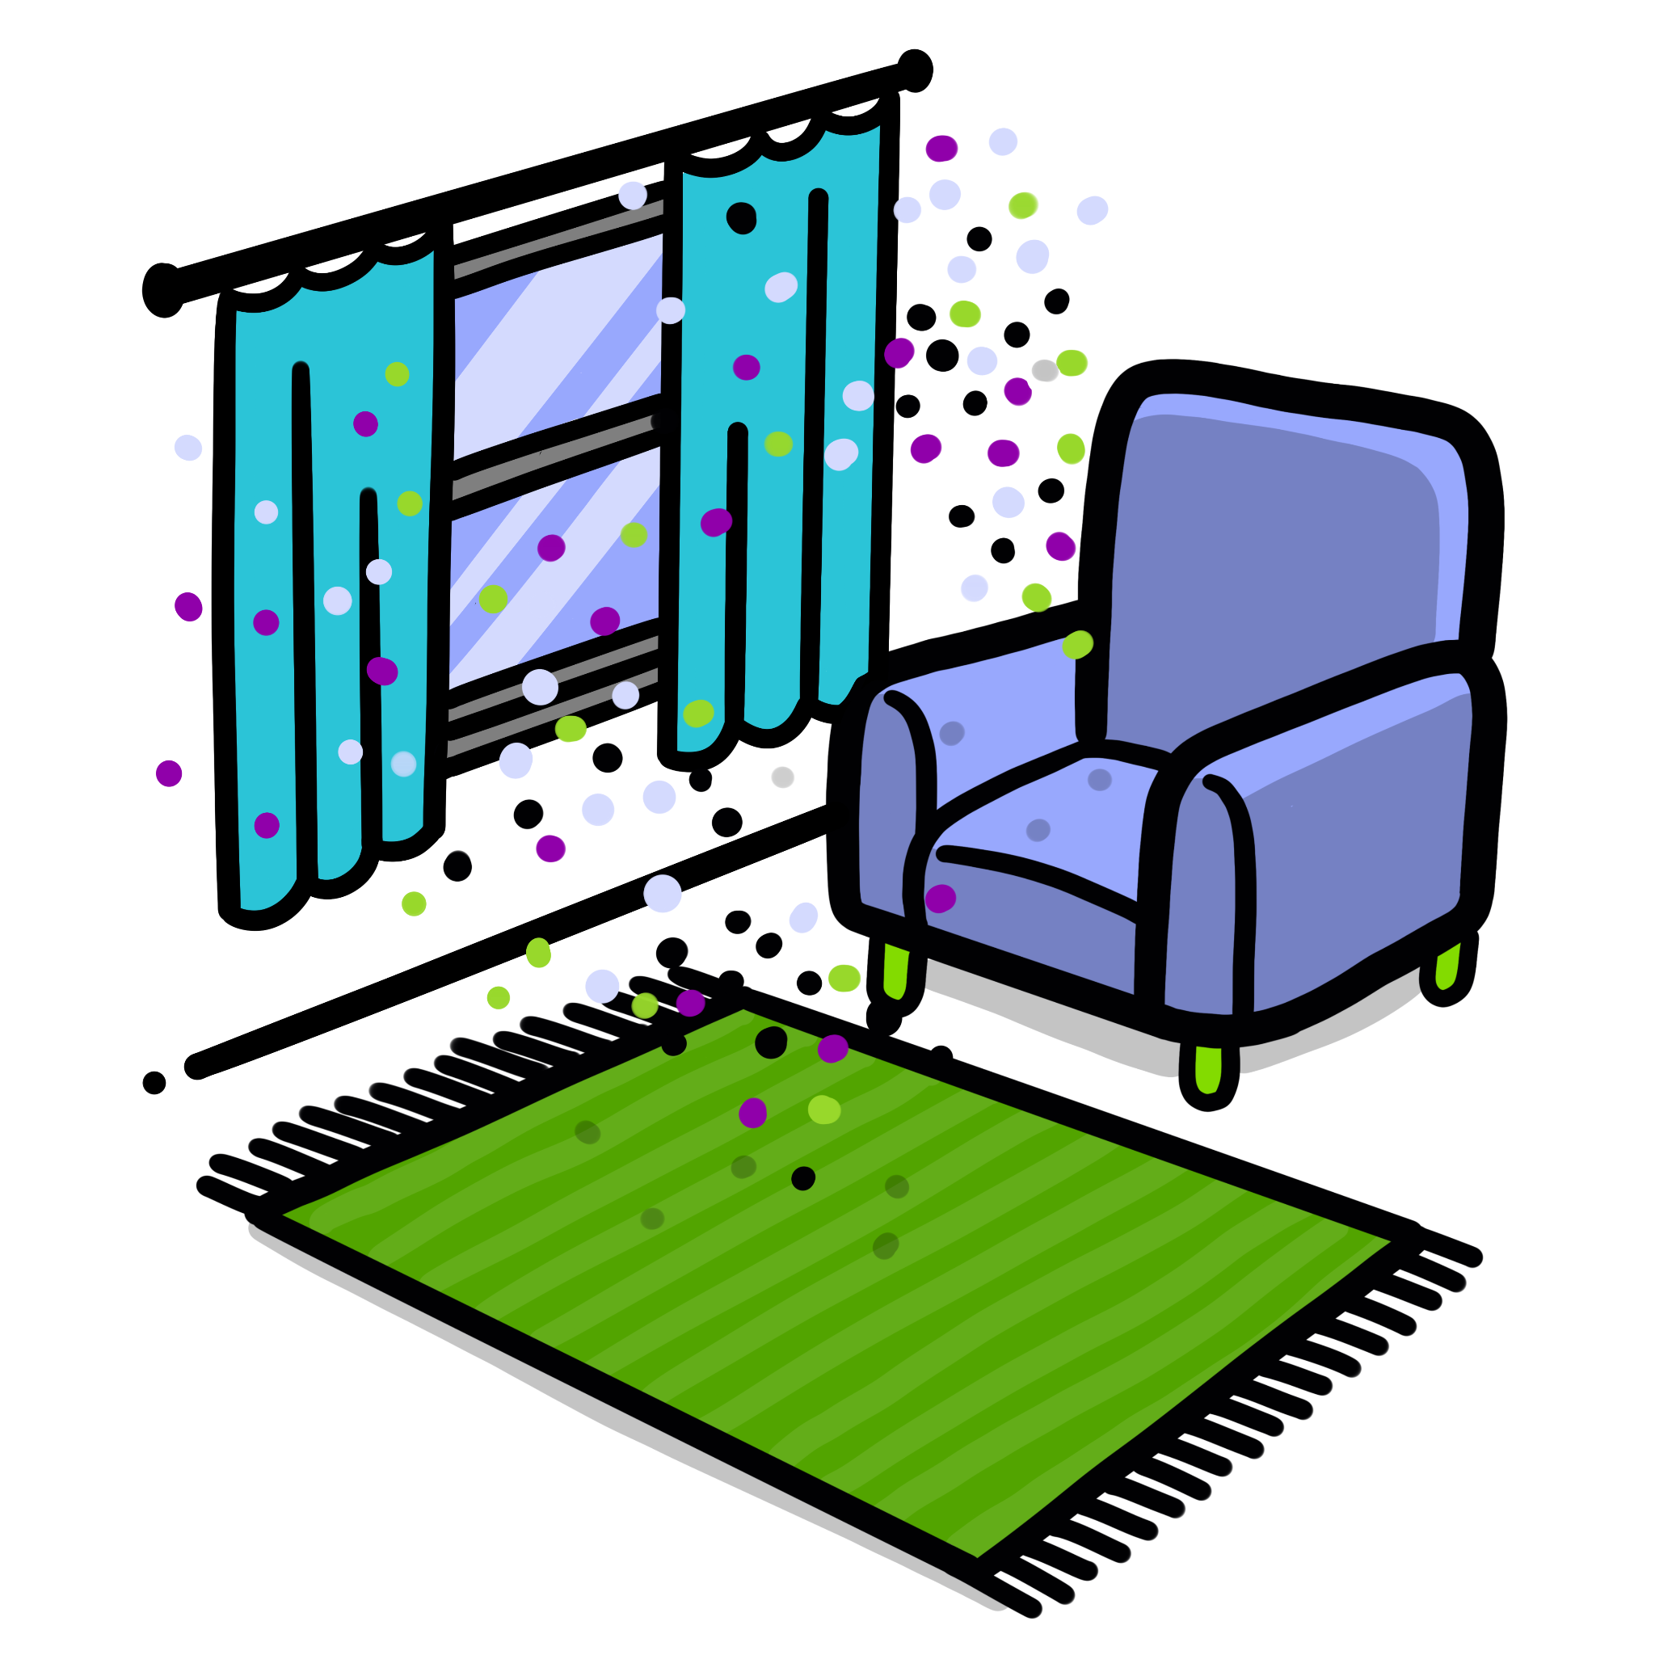
Challenges for improving IAQ
Air quality is largely invisible
Children are particularly vulnerable
Ventilation is very important - but challenges with rising energy costs
Raising awareness is critical
Tailored advice about actions is needed
Notes:
One of the challenges for taking action on air quality is that air pollution is invisible, therefore, it is ‘out of sight, out of mind’. Children and young people are particularly vulnerable to the effects of poor indoor air quality as their bodies (including lungs and brains) are still developing, they breath faster than adults so take in proportionally more air, and the average child spends less than two hours a day outside.
Ventilation is a very important part of ensuring good indoor air quality, but with high energy prices, many schools are reluctant to open windows.
Raising awareness of the importance of good air quality indoors, and the actions that people can
take to address this, for example, ventilating regularly, making sure fans and mechanical ventilation systems are well maintained, introducing air filters if opening windows is not an option, is an important way of improving air quality. Schools need advice that is tailored to their particular circumstances. We hope that SAMHE will help to provide this through activities such as Data Detectives, which allow them to explore spikes in their data and offer them suggestions of why they may have occurred.

Slide 12
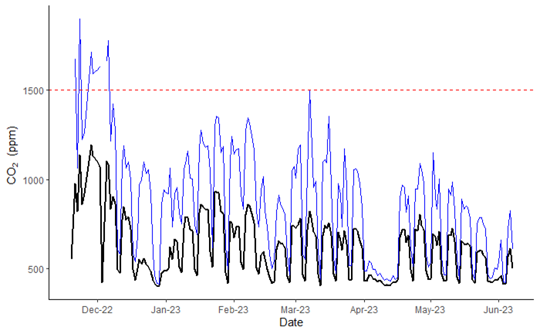
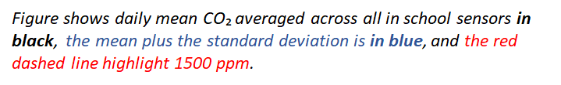
CO₂ data from 43 monitors
CO₂. daily means are largely below BB101 threshold of 1500 ppm for naturally ventilated classrooms.
Daily mean CO₂ exceeds 1500 ppm on ~2.5% of sensor-days
Notes:
I’m going to end with a few slides of data arising from the project so far, pulled together by my colleague Sam Wood at Imperial College London, just to show you the type of data we are getting. Here you can see carbon dioxide levels from XX schools, showing that XX and YY. And for PM you can also see variation xxx and axxxx.

Slide 13
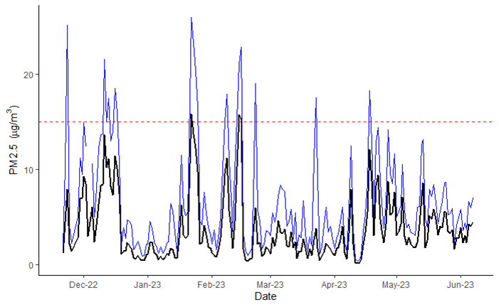
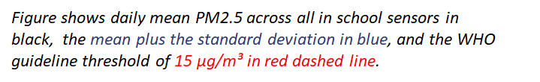
PM_{2.5} data from 43 monitors
PM_{2.5} daily means generally below 15 μg/m³ guideline recommended by WHO
Daily mean PM_{2.5} exceeds 15 μg/m³ on ~4% of sensor-days.

Slide 14

Get in touch!
www.samhe.org.uk
hello@samhe.org.uk, rhys.archer@york.ac.uk
Notes:
As you can hopefully tell, we’re really excited about this project and it is very popular with schools, and I’m very happy to discuss it with you further later in the session or afterwards. Thanks for listening.

